Slide 1
Assign a Macro
Notes:
https://www.excel-easy.com/vba/create-a-macro.html

Slide 2
Table of Contents
CREATING YOUR FIRST MACRO WITH A BUTTON
ASSIGN VALUE TO EXCEL CELL USING MACROS

Slide 3
CREATING YOUR FIRST MACRO WITH A BUTTON

Slide 4
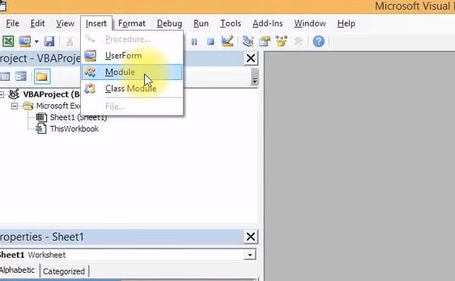
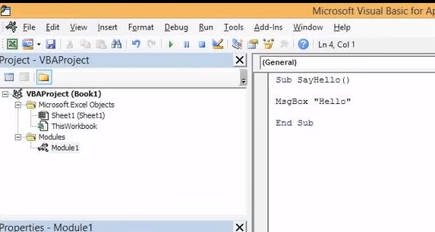
CREATE A MACRO
Add a new module
We structure codes using things called modules.
Go to the insert tab and select “Module”
The Module1 should appear in the project section
Write the codes as per the second image on the right *this are called routines

Slide 5
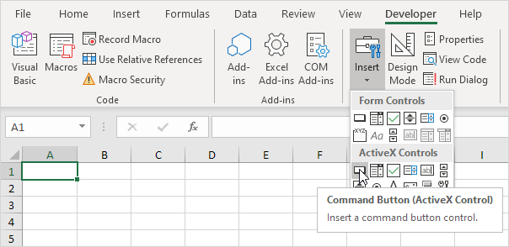
Command Button
Command Button
Going back to the Microsoft excel, to place a command button on your worksheet, execute the following steps.
1. On the Developer tab, click Insert.
2. In the ActiveX Controls group, click Command Button
3. Drag a command button on your worksheet.

Slide 6
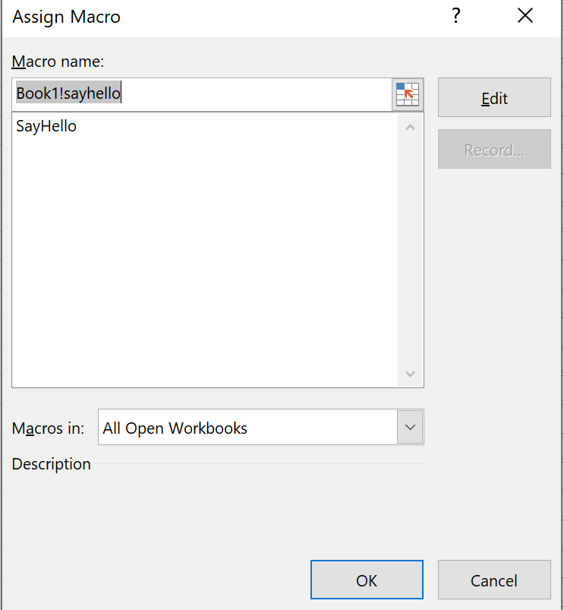
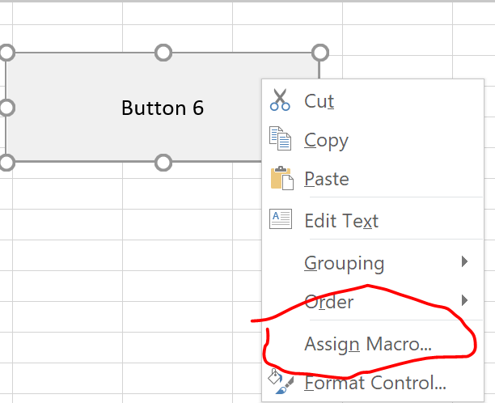
Assign a Macro
To assign a macro (one or more code lines) to the command button, execute the following steps.
1. Right click on the button
2. Select Assign Macro
3. In the Assign Macro menu, select the “sayHello” and click OK.

Slide 7
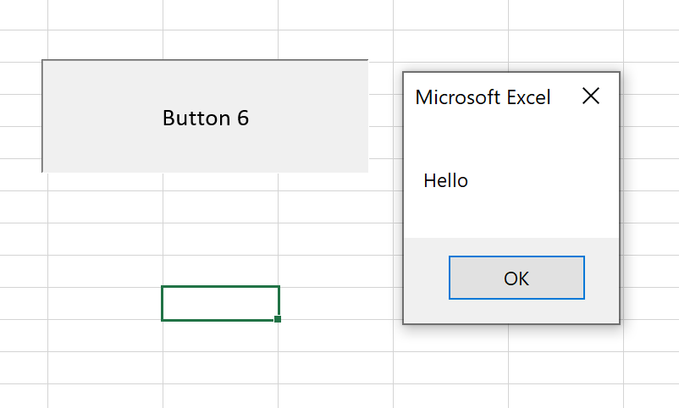
Expected Output
On clicking the button. A pop-up menu should come out and say “Hello”

Slide 8
ASSIGN value to excel cell using macros

Slide 9
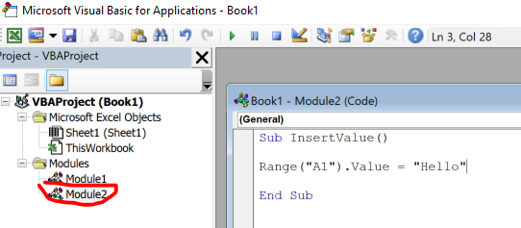
CREATE A MACRO
Add a new module
We structure codes again using a new module.
Go to the insert tab and select “Module”
The Module2 should appear in the project section
Write the codes as per the second image on the right *this are called routines

Slide 10
Command Button
Command Button
Going back to the Microsoft excel, to place a command button on your worksheet, execute the following steps.
1. On the Developer tab, click Insert.
2. In the ActiveX Controls group, click Command Button
3. Drag a command button on your worksheet.

Slide 11
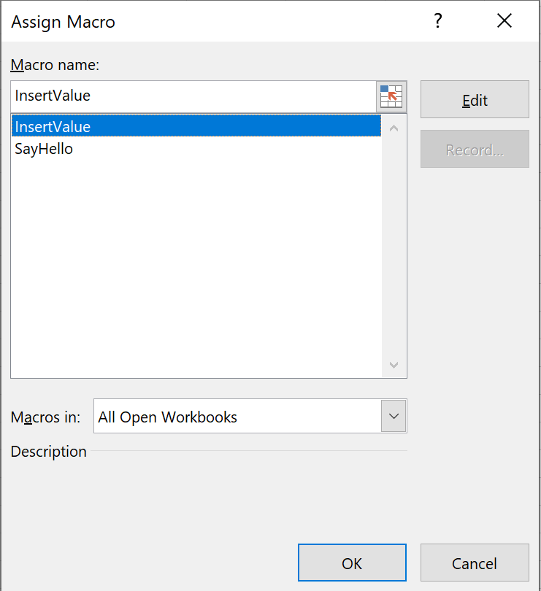
Assign a Macro
To assign a macro (one or more code lines) to the command button, execute the following steps.
1. Right click on the button
2. Select Assign Macro
3. In the Assign Macro menu, select the “InsertValue” and click OK.

Slide 12
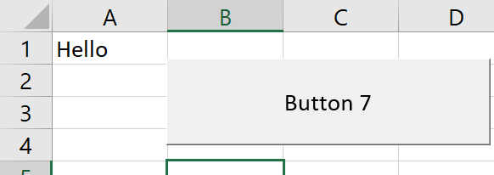
Expected Output
On clicking the button. A cell A1 should display “Hello”

Slide 13
EXERCISE

Slide 14

Exercise – (10 – 15 mIns)
Draw a square or a rectangle using excel VBA.
You are supposed to color using excel VBA dun self color!
On click of the button, the box or rectangle should appear
Color of the box does not matter but use this opportunity to explore VBA further.
https://www.excel-easy.com/vba/examples/background-colors.html#:~:text=Changing%20background%20colors%20in%20Excel,background%20color%20of%20a%20cell.
Notes:
How can this be useful, u may require to color cells on demand when doing your work. You achieve this through clicking ur button.
If u can color squares definitely can color the cells required for work in the future

